Slide 1

AI training group
Weekly Report
Nguyen khai phu – Aug 18 2023

Slide 2
Difficulties in collecting data
ISP008 foundation
Each project group manages their work on their own JIRA server -> need permission from multiple groups to diversify data sources
No statistical records on different types of bugs
No “tags” for failed test cases -> search by keywords
Video quality:
Phone cameras -> blurry, low resolution
Some videos do not capture the whole screen (missing 10% to 50% of screen size)
No camera holder -> shaking
Different types of screens
Others
2
CISP-1352-A21 - ISP-DOC-STYLETYPE-Templates © Robert Bosch GmbH 2016. All rights reserved, also regarding any disposal, exploitation, reproduction, editing, distribution, as well as in the event of applications for industrial property rights.

Slide 3
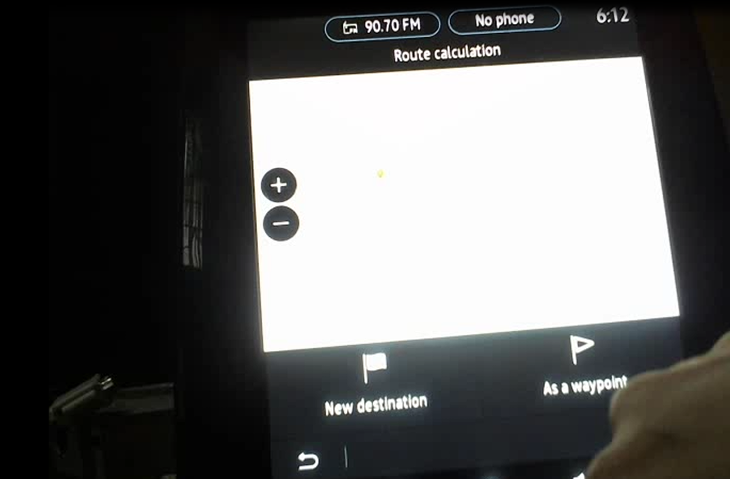
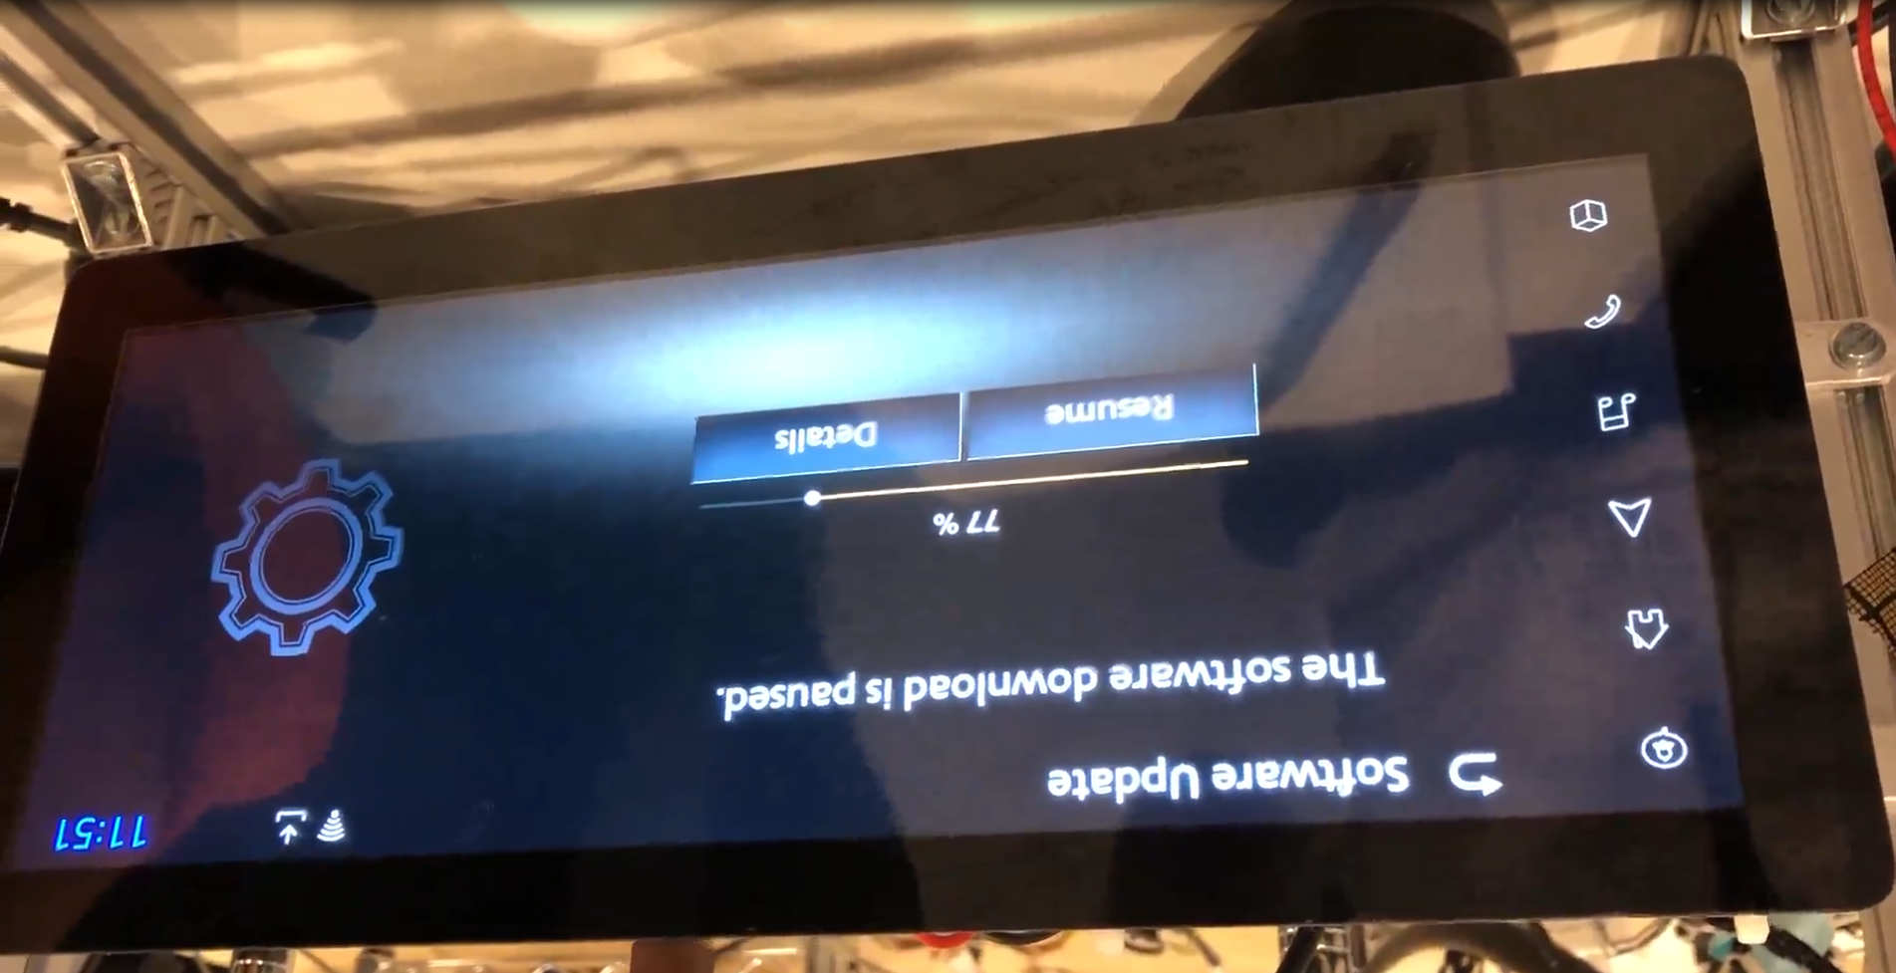
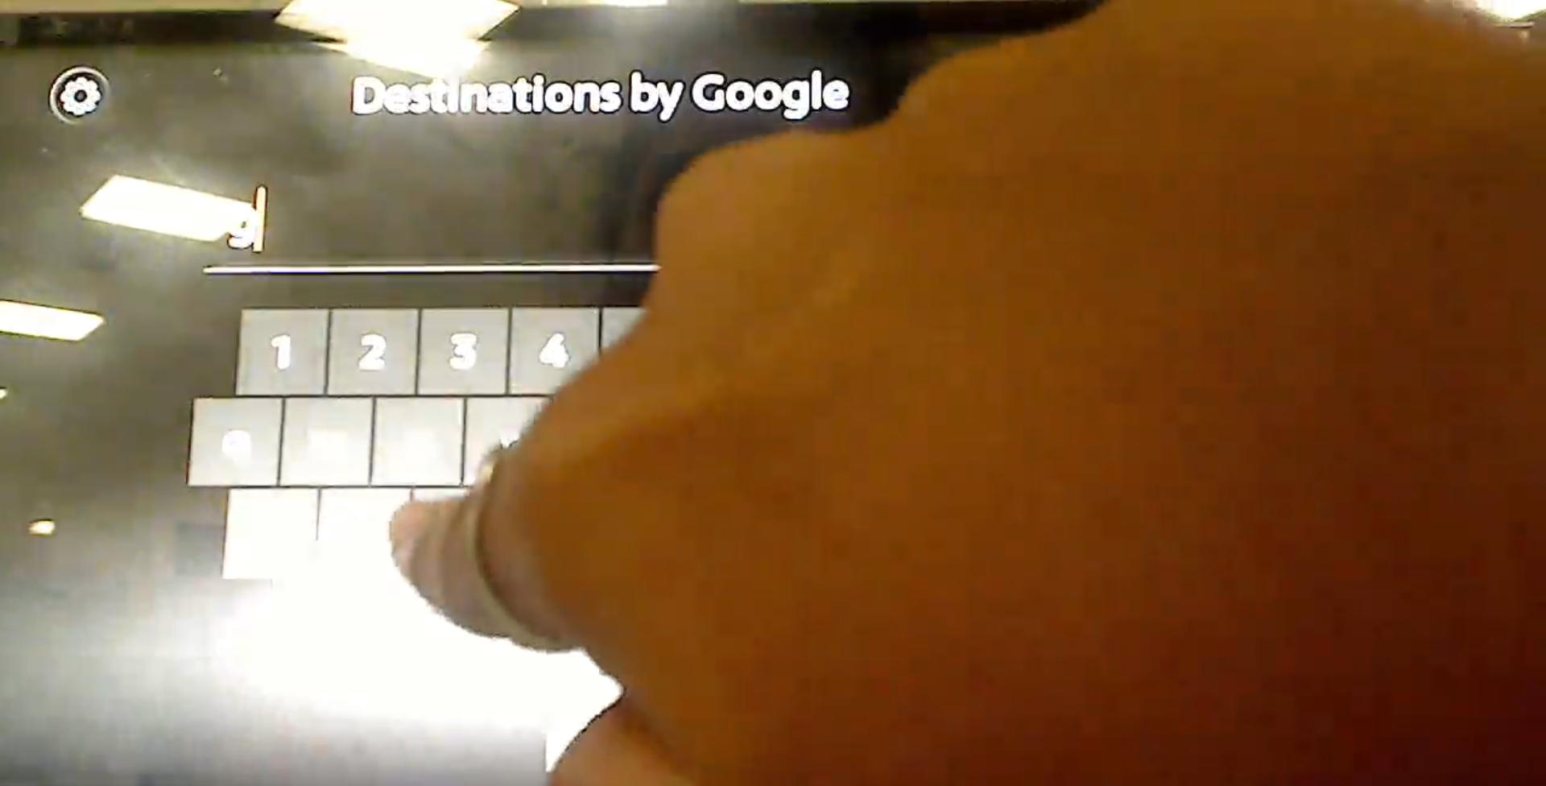
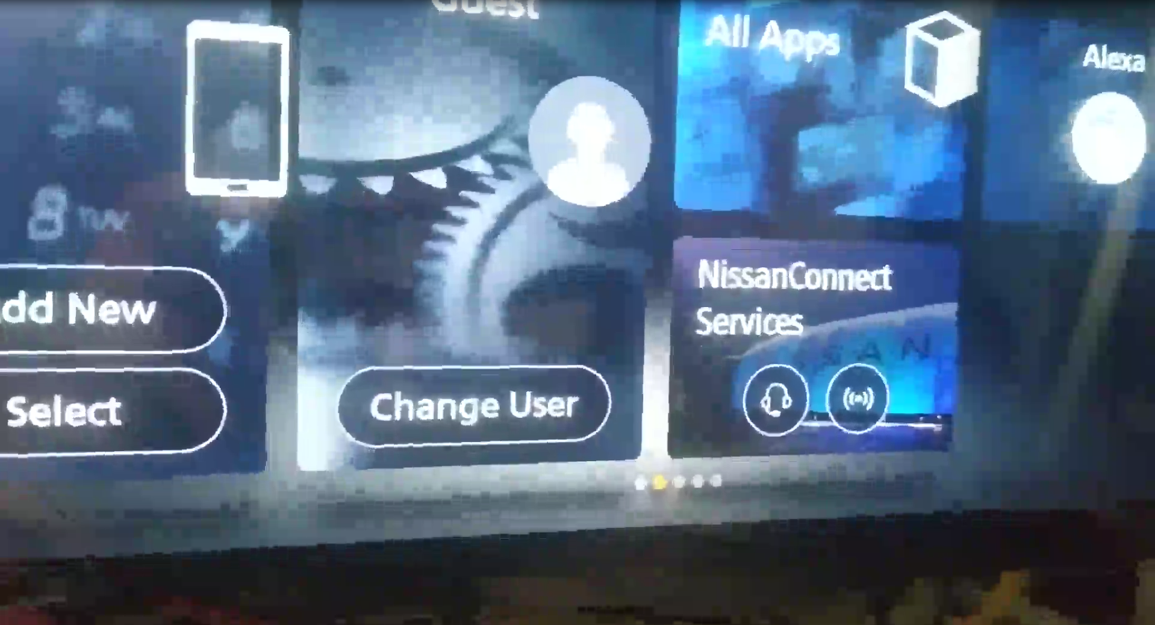
Difficulties in collecting data
ISP008 foundation
2
CISP-1352-A21 - ISP-DOC-STYLETYPE-Templates © Robert Bosch GmbH 2016. All rights reserved, also regarding any disposal, exploitation, reproduction, editing, distribution, as well as in the event of applications for industrial property rights.

Slide 4
Mr Trung’s recommendations
ISP008 foundation
Anh Trung’s recommendations: reproduce the flicker bugs, manually record to make our own data
Advantages:
Control the quality, conditions, camera angles, duration,…
Disadvantages
Flash a device -> time-consuming
Device shortage (head units, screens)
Learn how to operate the devices
Camera?
2
CISP-1352-A21 - ISP-DOC-STYLETYPE-Templates © Robert Bosch GmbH 2016. All rights reserved, also regarding any disposal, exploitation, reproduction, editing, distribution, as well as in the event of applications for industrial property rights.

Slide 5
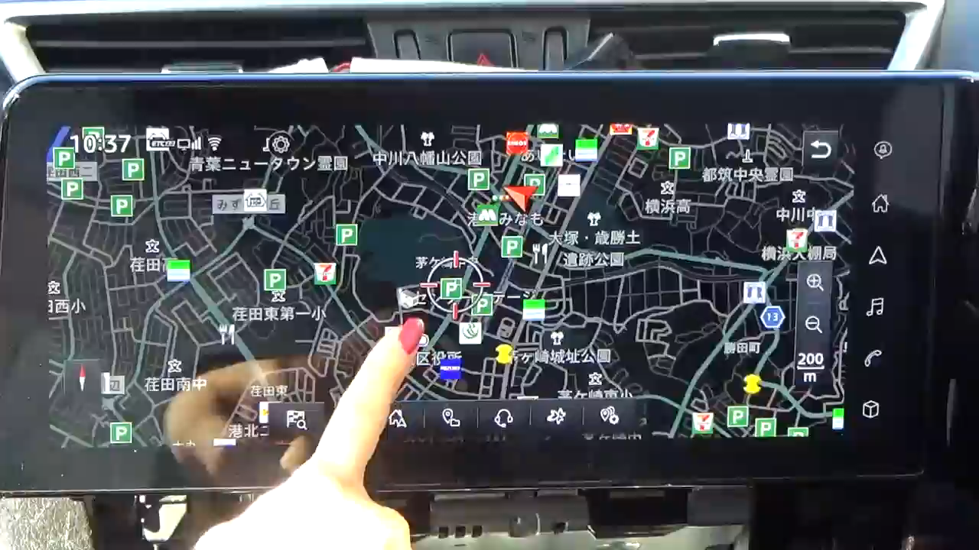
Case 1
ISP008 foundation
2
CISP-1352-A21 - ISP-DOC-STYLETYPE-Templates © Robert Bosch GmbH 2016. All rights reserved, also regarding any disposal, exploitation, reproduction, editing, distribution, as well as in the event of applications for industrial property rights.

Slide 6
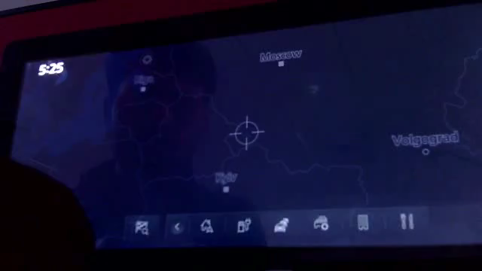
Case 1
ISP008 foundation
2
CISP-1352-A21 - ISP-DOC-STYLETYPE-Templates © Robert Bosch GmbH 2016. All rights reserved, also regarding any disposal, exploitation, reproduction, editing, distribution, as well as in the event of applications for industrial property rights.

Slide 7
Group 1: flashing rapidly
ISP008 foundation
Objects (boxes, windows,...) or even the whole frame flash rapidly
“On” and “off” frames alternating
Backgrounds add more variance
2
Internal | C/ISP Krautschneider | 07.12.2017 V1.0
CISP-1352-A21 - ISP-DOC-STYLETYPE-Templates © Robert Bosch GmbH 2016. All rights reserved, also regarding any disposal, exploitation, reproduction, editing, distribution, as well as in the event of applications for industrial property rights.

Slide 8
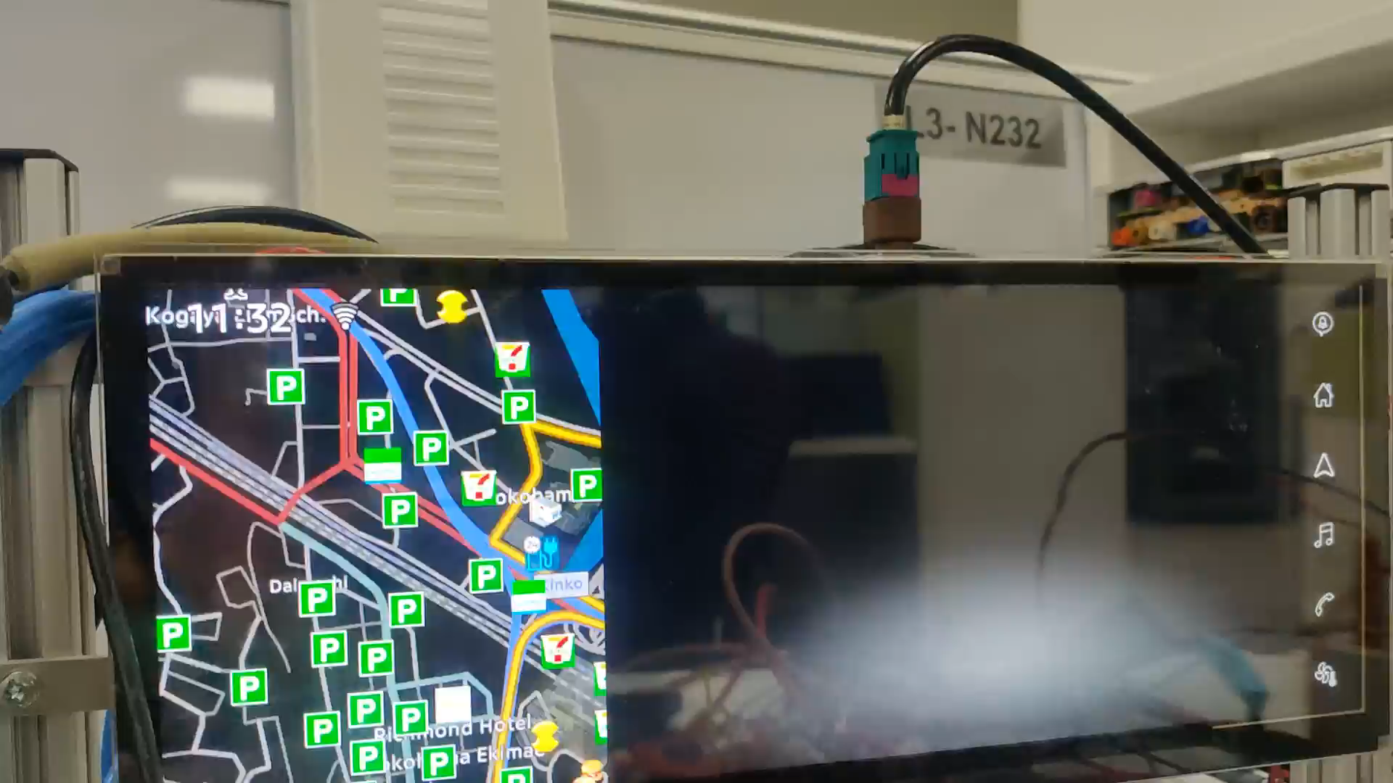
Case 2
ISP008 foundation
2
CISP-1352-A21 - ISP-DOC-STYLETYPE-Templates © Robert Bosch GmbH 2016. All rights reserved, also regarding any disposal, exploitation, reproduction, editing, distribution, as well as in the event of applications for industrial property rights.

Slide 9
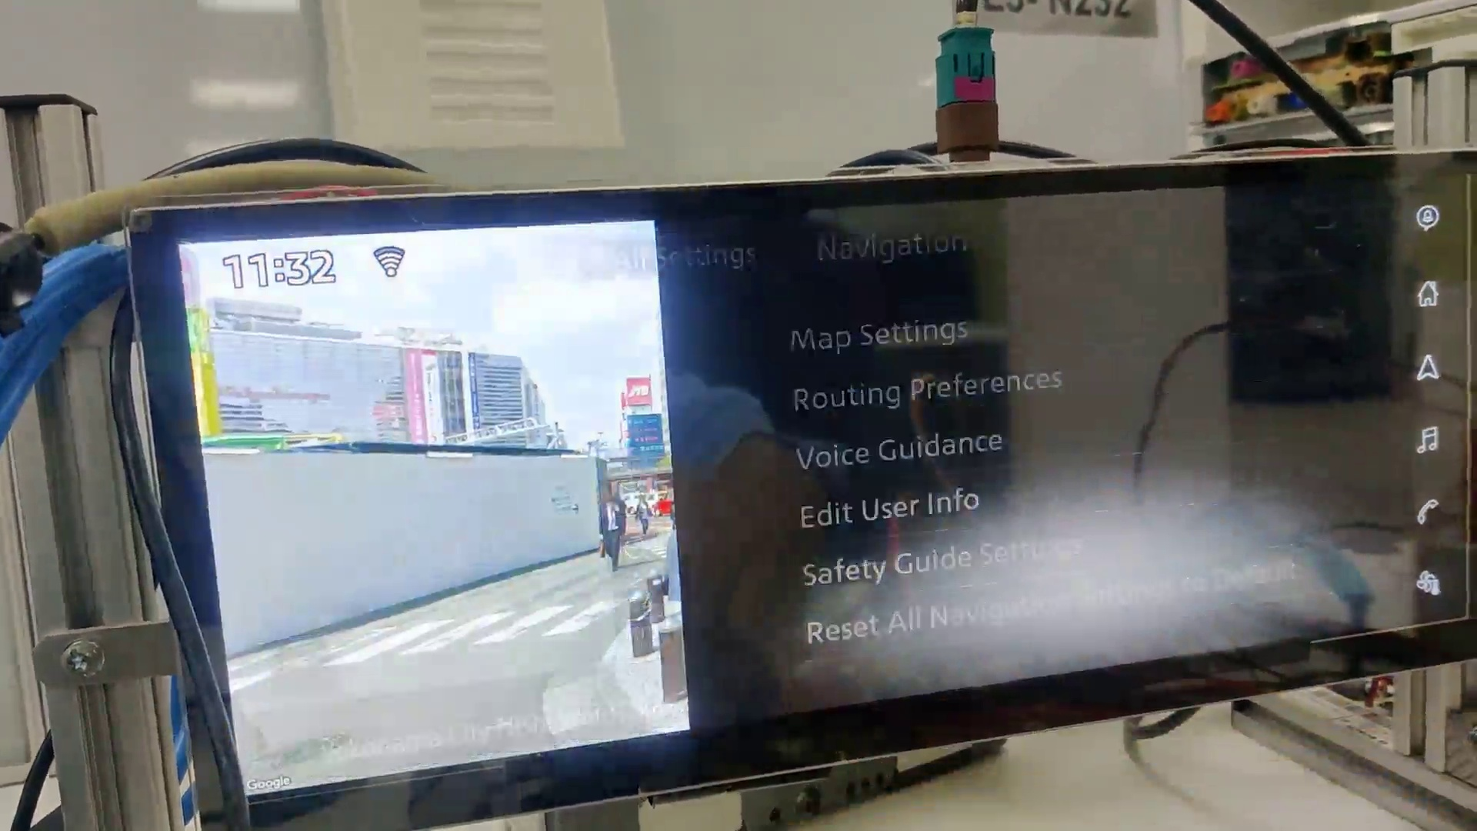
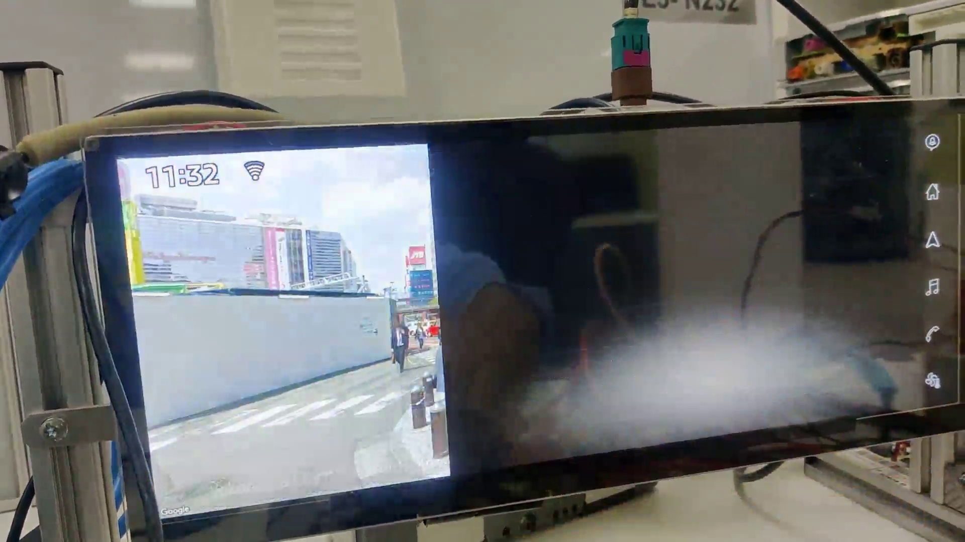
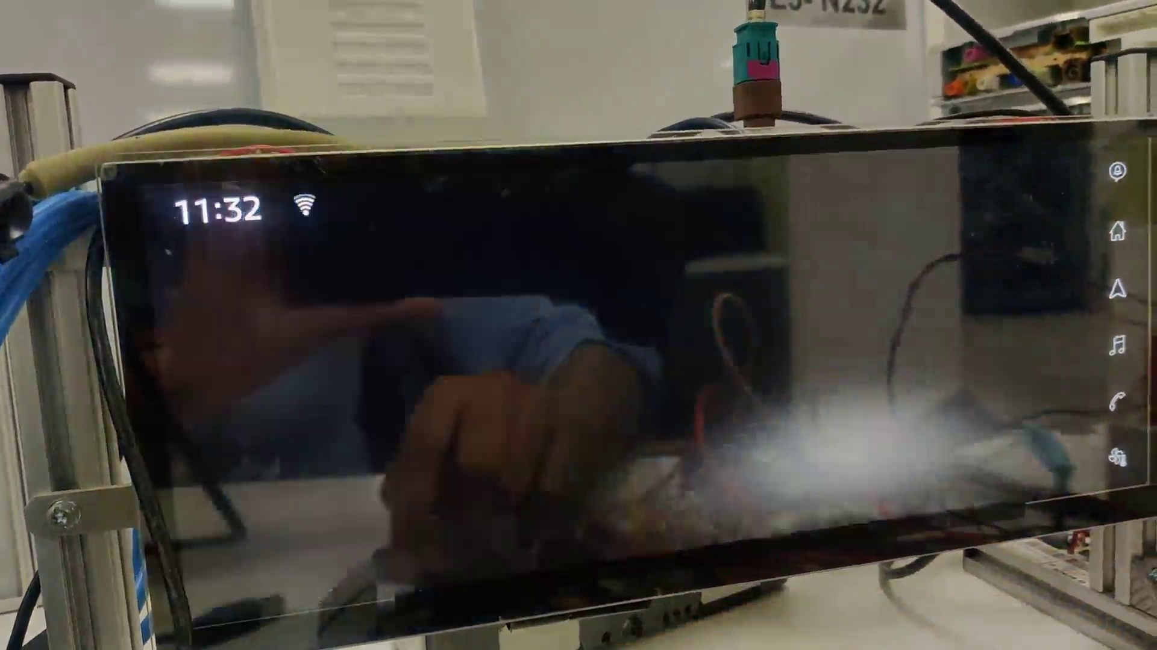
Group 2: 1-3 frames
ISP008 foundation
Happens in the span of just a number of frames
Not always black screen
Difficult to detect if it happens in screen transitions
Might depend on customers’ requirements
2
CISP-1352-A21 - ISP-DOC-STYLETYPE-Templates © Robert Bosch GmbH 2016. All rights reserved, also regarding any disposal, exploitation, reproduction, editing, distribution, as well as in the event of applications for industrial property rights.

Slide 10
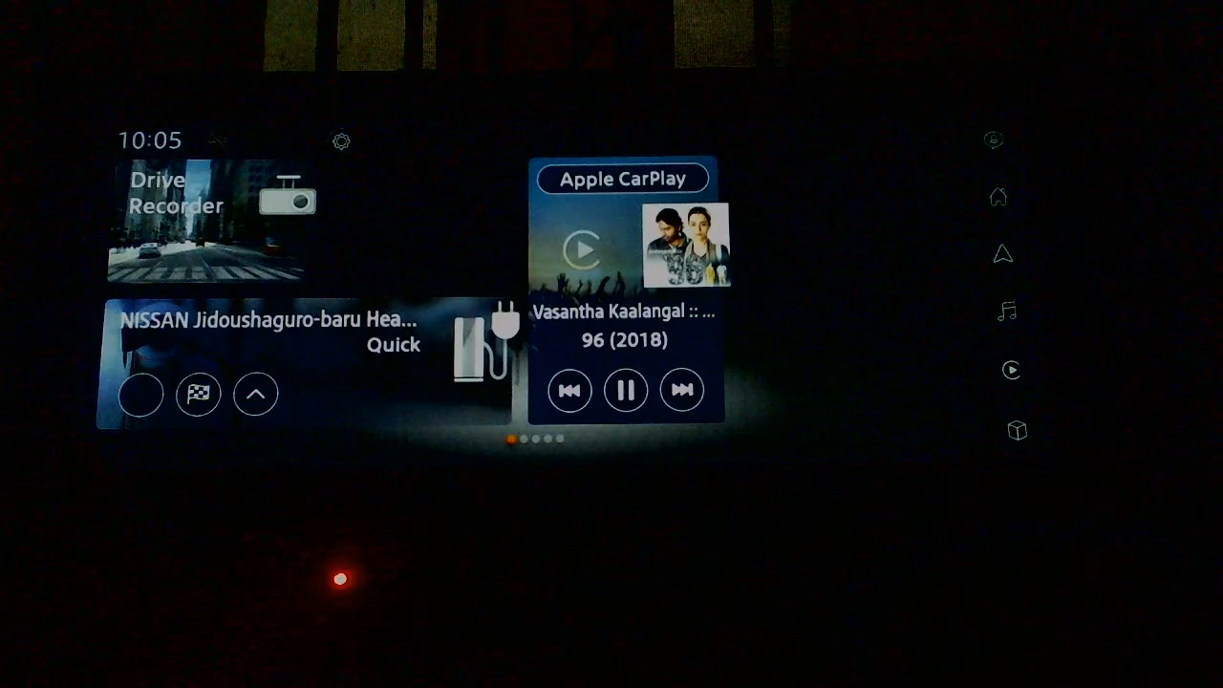

Slide 11
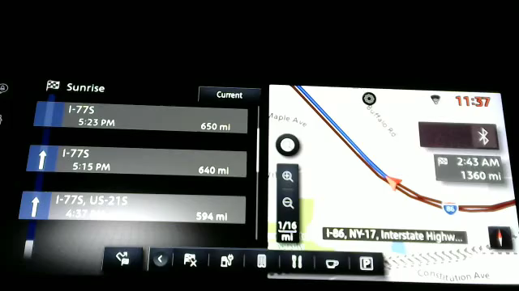

Slide 12
Group 3: sliders
ISP008 foundation
Cannot identify whether there is a bug or not by just solely based on the information on the screen
Last week: track fingertips and slider
Tracking items’ movement ?
2
CISP-1352-A21 - ISP-DOC-STYLETYPE-Templates © Robert Bosch GmbH 2016. All rights reserved, also regarding any disposal, exploitation, reproduction, editing, distribution, as well as in the event of applications for industrial property rights.

Slide 13
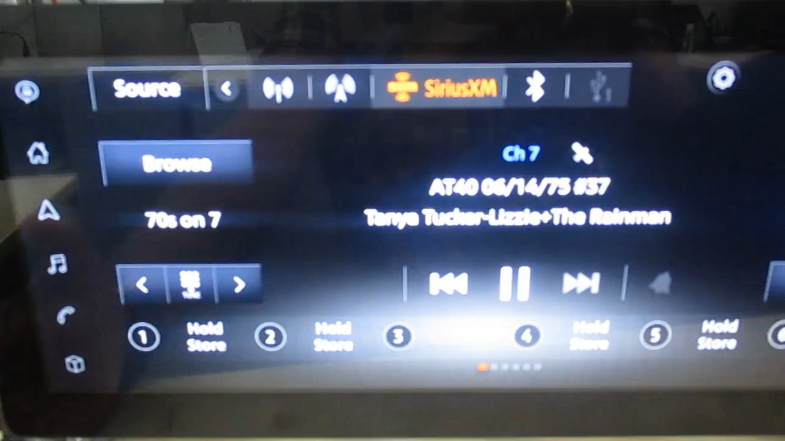

Slide 14
Object-specific
ISP008 foundation
Predictive keyboard: the keyboard tries to predict which numbers can return a result and which cannot (grayed out)
Apart from the numbers blinking, for the most part, the screen works “normally”
Specific to certain objects
Identified as a flicker because the sequence is different from customer’s expectation.
Depends on requirements
2
CISP-1352-A21 - ISP-DOC-STYLETYPE-Templates © Robert Bosch GmbH 2016. All rights reserved, also regarding any disposal, exploitation, reproduction, editing, distribution, as well as in the event of applications for industrial property rights.

